Slide 1


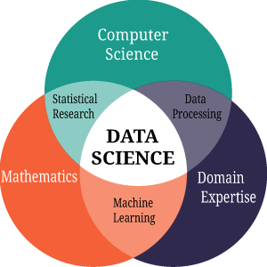
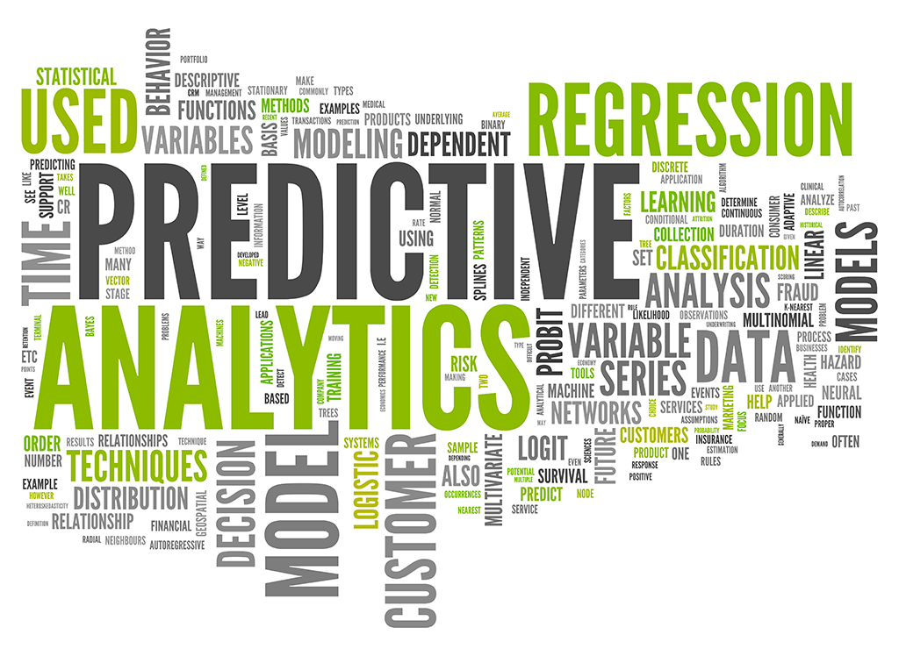


Rob Thomas, Solution Architect, Global Business Intelligence and Revenue Operations
Application of R with Marketing Analytics
October 30, 2018
COBRAND NAME

Slide 3
AGENDA
Cross Functional Challenges
Predictive Analytics / Data Warehouse Justification
Marketing Funnel (Domain Knowledge)
Previous State v Current State
Integrating with Plumber, Data Lake, R Studio, & Analytics
How Did We Accomplish Our Goals
Take the SMART Approach
Q & A

Slide 4



PROBLEM STATEMENT
Cross-Functional Analytics Challenges
Missing Meaningful Insights From Underlying Data
Missing Predictive Capabilities
Missing Strategic
Decision KPIs
Missing analytical tools where multiple data sources could be blended
Siloed data with no shared repository/data warehouse
Missing historic trend data for predictive analysis
Inability to leverage statistic concepts and data mining to define logic for potential future outcomes
Missing historic trend data need to optimize predictive modeling
Inability to address the best case scenario with the data
Unable to action from trends, factors/insights from underlying data
Notes:
The lack of analytical tools have made it challenging to understand the data and identify the patterns/insights that inherently exist in it.
Data sources are stored in siloes with no shared repository/data warehouse.
Unable to identify patterns or trends that define pre-sales, sales, and post sales data overtime.
Inability to predict the future based upon the factors in the data
Inability to leverage the statistical and data mining concepts with the data to define a function/logic for the potential future outcome.
Unable to make actionable the trends/factors/insights from the underlying data insight.
Inability to address the “What will happen” scenario with the data.
Inability optimize business strategy by learning's overtime
Inability to address the “What best can happen” scenario with the data.
Inability to apply advanced level of concepts to optimize the predictions further.

Slide 5



Executive summary
Data Warehouse Justification
Why a Data Warehouse?
Why Now?
Needed a decision support system (DSS) to evaluate enterprise-wide performance over time.
Needed to drive strategic decisions while supporting strategic initiatives during hyper growth.
Why Marketing Analytics?
Next Steps
Needed to measure, manage, and analyze performance across ALL marketing channels to maximize effectiveness and optimize ROI.
Move forward with an analytics strategy to tie data siloes together = Tableau, phased release approach.

Slide 6
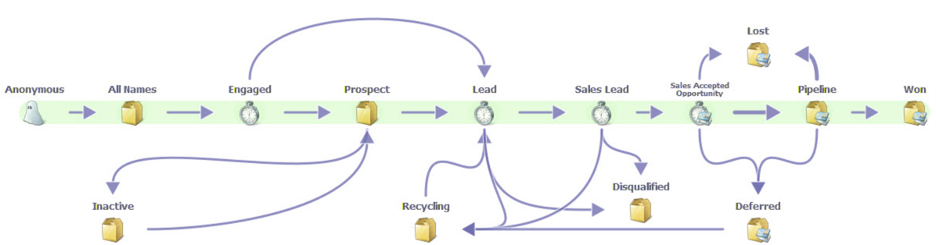
BUSINESS Challenge
Marketing Funnel (Understanding the Domain Knowledge)

Slide 7
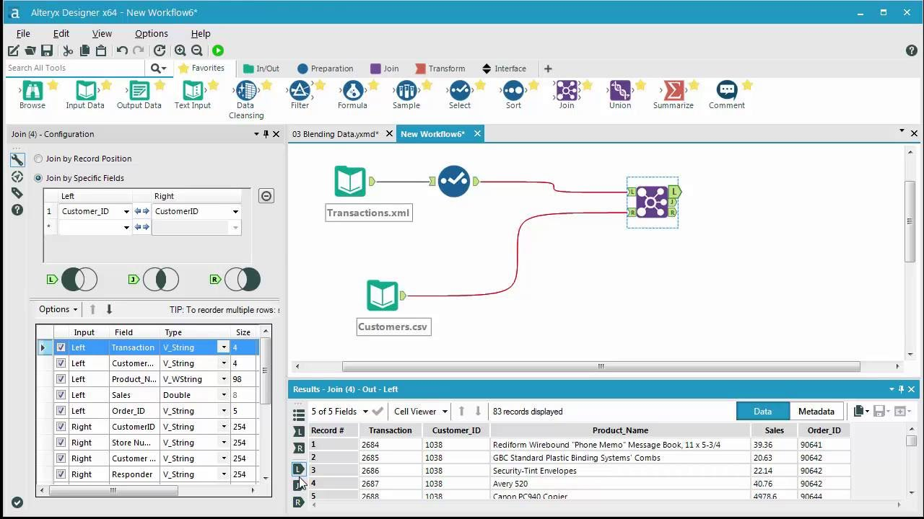
Proof of Concept (alteryx)
Made priority analytics available early with high visibility to gain early adoption
Took an iterative approach, focusing where we knew would get buy-in
Prioritized revenue impacting data collection for initial launches
Laid out long term strategy with timelines and continued to deliver enhanced analytics on time

Slide 8


BUSINESS INTELLIGENCE Architecture
Previous State
CRM
Missing Key KPIs
No DW and
No Predictive Analytics
Lead Lifecycle
Pipeline Lifecycle
Cost Per Sale
Cost Per Lead
Sales/Marketing Attribution
Marketing ROI
No Predictive Capabilities
=
Marketing
Automation
Website
ERP

Slide 9
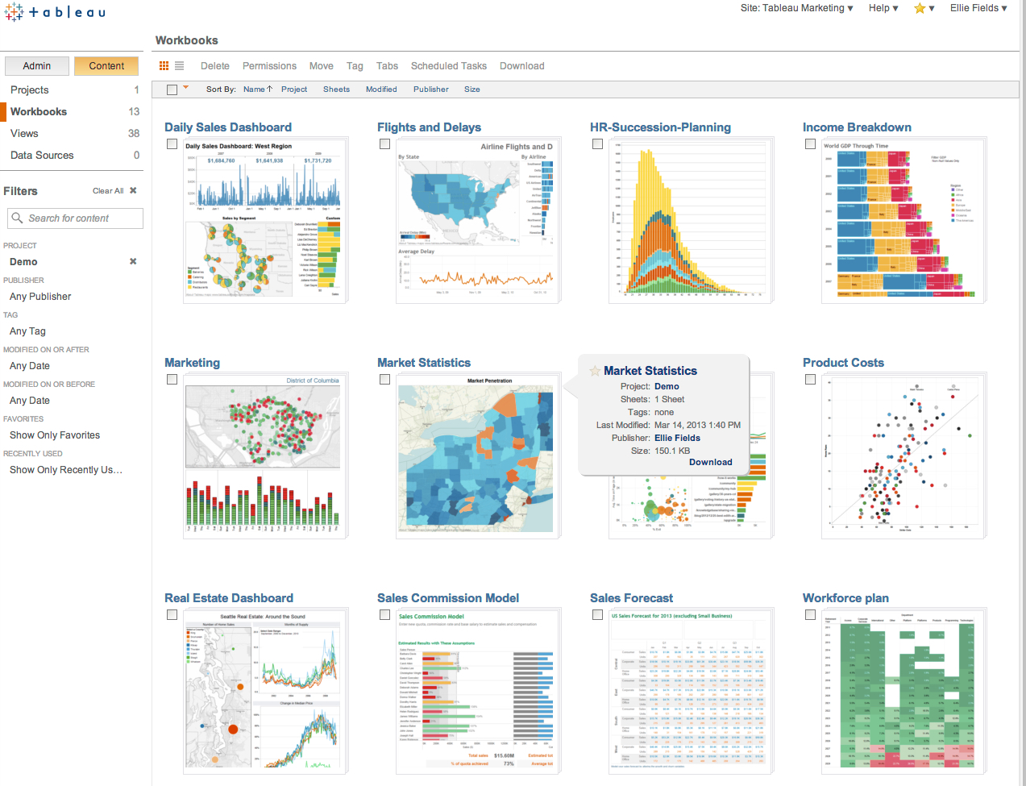
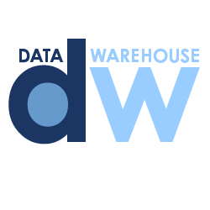
BUSINESS INTELLIGENCE Architecture
Current State
Analytics Transformation
CRM
ETL/ELT
Analytics Platform
Marketing
Automation
Predictive KPIs Available
Lead Lifecycle
Pipeline Lifecycle
Cost Per Sale
Cost Per Lead
Sales/Marketing Attribution
Marketing ROI
Predictive Capabilities
Website
R Studio
ERP

Slide 10



BUSINESS INTELLIGENCE Architecture
Integration & Data Lake: Database Tables
Data Validation
Data Cleaning
Data Transformation
Data Aggregation
Data Loading
Data Lake
Load Tables
Stage Tables
Data
Virtual Tables

Slide 11

BUSINESS INTELLIGENCE Architecture
Integration to R Studio
OLAP Analysis
OLAP Cubes
MD Cubes
Data Marts
Star Schema
TidyVerse (Data Science)
Plumber (API’s)
Interactive Graphics
Swagger

Slide 12
BUSINESS INTELLIGENCE Architecture
Data Warehouse Automation & Analytics
OLAP Analysis
OLAP Cubes
MD Cubes
Data Marts
Star Schema
Advanced Charts & Dashboards
Statistical Analysis
Advanced Calculations
Analyzing Time-Based Data

Slide 13
Plumber Webservice API Calls
Security
AEMv
RConnect/IPaaS
Data
Warehouse
Outbound REST Request
RStudio
Saved Search End Point
JSON API call
REST Response with Payload
Plumber API’s
Notes:
Open Source R Package compose a Web Service API from you exiting R functions

Slide 14





Approach
How Did We Accomplish Our Goals
Requirements and Sign Off
Approach
Sign Off
Knowing the
Risk, Run Forward
Risk
Evaluation
Stakeholder-driven, documented requirements with sign off
Partner Verification
Stakeholder sign off on final requirements, approach,
risks and goals
Kick off with clear timelines, expectations and goals
Set expectations about what we know and succeed, and what is unknown
Verify best practices and scope with
our partners
Notes:
Requirements documentation sign off where we set expectations around a phased approach – succeed often, pivot quickly to close up issues
Partnered with our vendors to hear about success stories and determine best path for success for our company
Evaluated Risks- looked at areas where we knew we would hit goals and mapped out where it was uncertain so we could focus on what we did not know without testing

Slide 15
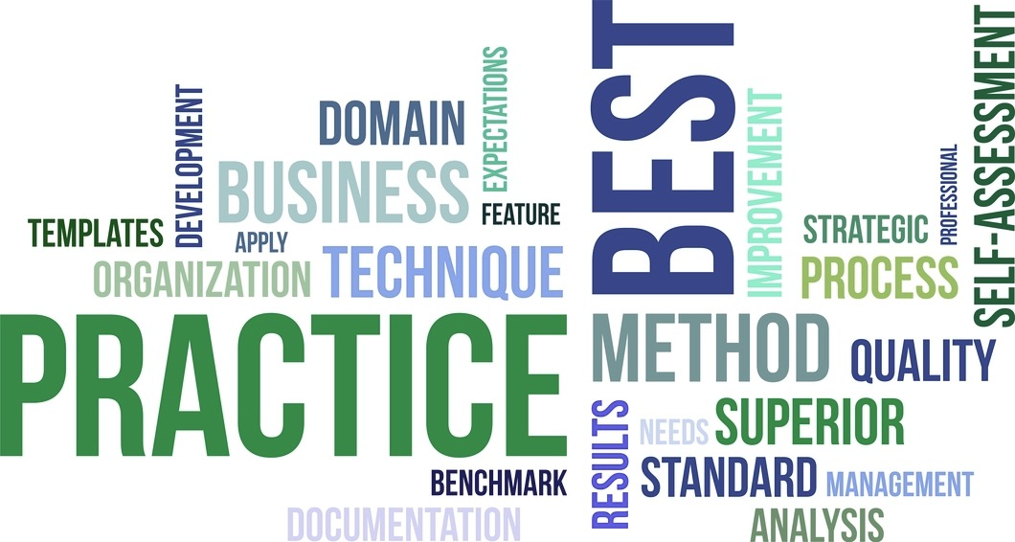
outcomes
Lessons Learned and Best Practices
Stakeholder buy-in is critical
Address Change Management early and often
Clearly document project charters including requirements, stakeholders, goals and objectives, timelines, impact across the business, what success looks like
Follow best practice development standards
Follow security and compliance standards from the onset
Share results, get feedback, pivot for success
Future-proof by involving cross-functional teams to lay out impact
Accept that not meeting perfection doesn’t mean failure

Slide 16
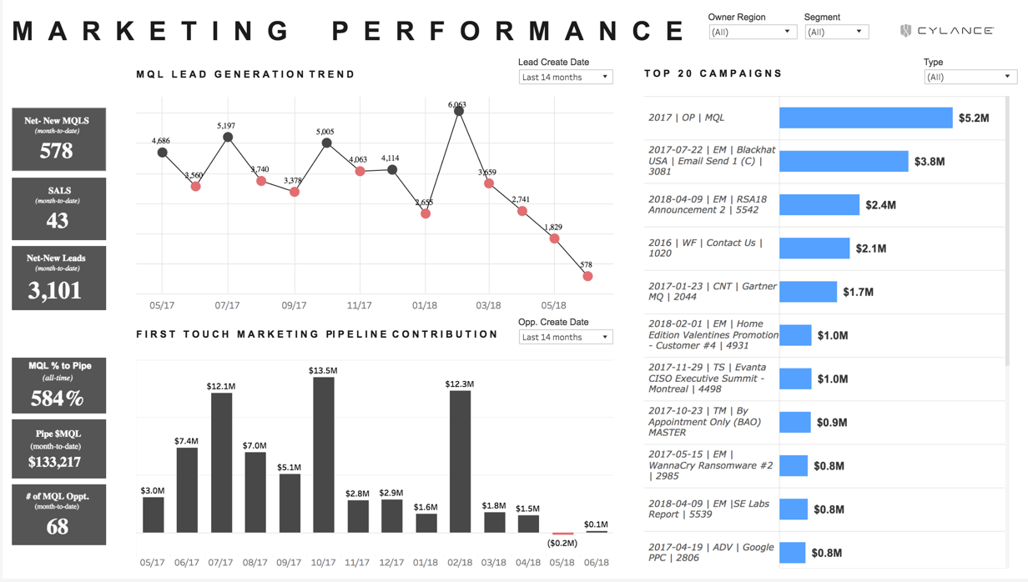
outcomes
Marketing Analytics Dashboard

Slide 17
Key takeaways
Take the SMART Approach
Socialized what we could specifically solve and when with key stakeholders
Made priority analytics available early with high visibility to gain early adoption
Took an iterative approach, focusing where we knew would get buy-in
Prioritized revenue impacting data collection for initial launches
Laid out long term strategy with timelines and continued to deliver enhanced analytics on time
Specific
Measurable
Attainable
Relevant
Time Based

Slide 18


Slide 19
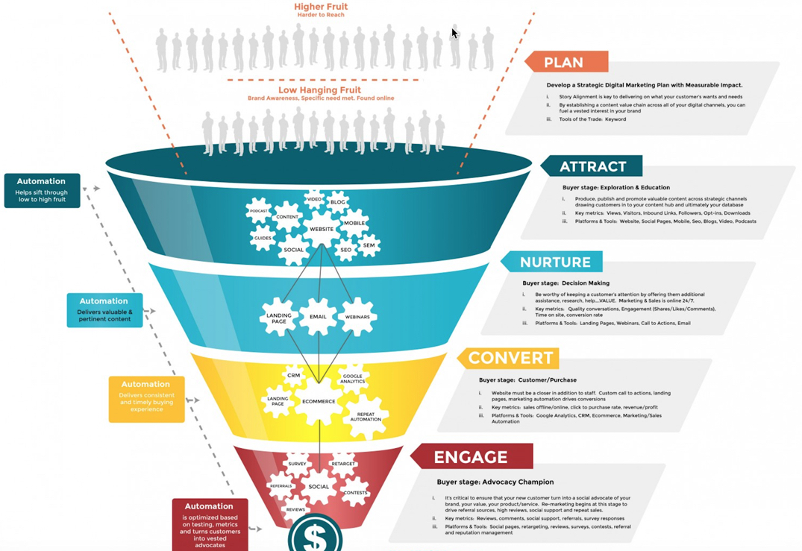
ENGaGeMENT JOURNEY
Marketing Funnel

